Slide 1
Mark-Anthony Hutton
Xvid Video/Audio Codec
CS525 Multimedia Computing
Dr. Edward Chow
05/03/10

Slide 2
Outline
What is Xvid?
Encoding/Decoding with Xvid
Xvid Project Results
Video Comparison

Slide 3
What is Xvid?
Open Source License
Cross Platform
MPEG-4 video compression
H.263 Motion Compensation
Inter-Frame
Cross Compatibility
Notes:
Open Source: answer to divx (proprietary) under the GNU GPL
Cross Platform: any
MP4 v. c.: ASP(Advanced Simple Profile) compression encoding / decoding
H.263: used in blu-ray, YouTube, iTunes store, cable television. Provide good video quality with substantially lower bit rates.
Cross Compatibility: DivX, DX50, mp4v

Slide 4
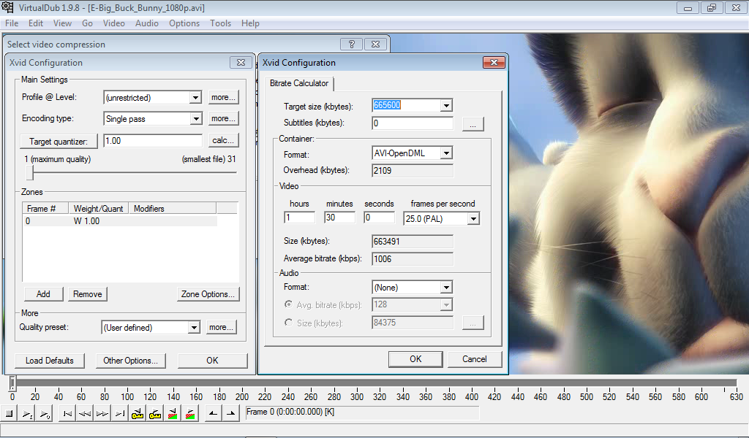
Encoding/Decoding with Xvid

Slide 5
Xvid Project Results
Open Content Licensed: Big Buck Bunny
Using a 26.25 sec clip
Uncompressed: 3.64 GB 1920x1080, 24.00 fps, 630 frames, 1194.4 mbps (0% overhead)
Compressed using Xvid MPEG-4 Codec: 48.3 MB
I:VOP: 5 (key frames), Quantized: 1
P:VOP: 239, Quantized: 1
B-VOP: 386, Quantized: 2
Total: 630, Average Quantization: 1.61
1920X1080, 24.00 fps, 630 frames, 15.4 mbps (0.03% overhead)
Ratio: 77 : 1
Notes:
Licensed under Creative Commons Attribution 3.0 License
Xvid was set using maximum quality criteria

Slide 6
Video Comparison
Refer to netbook…

Slide 7
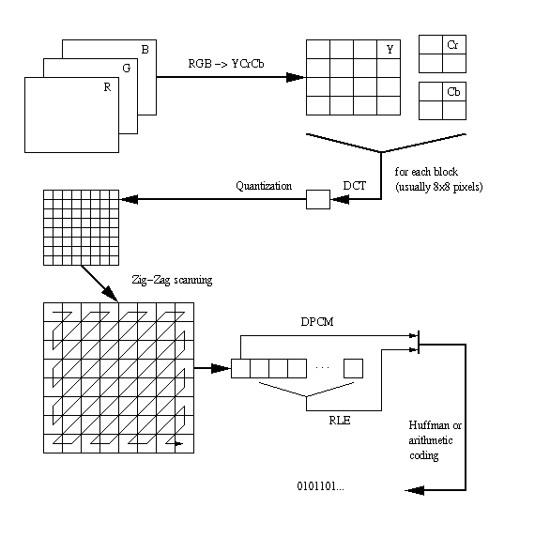
Why such a difference?
Notes:
Trellis quantization

Slide 8
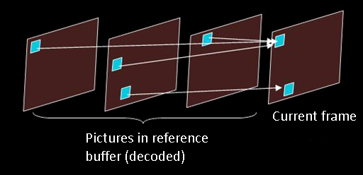
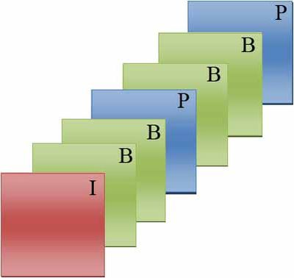
Why? Continued…
Notes:
Not too much detail, since there is a project on this

Slide 9
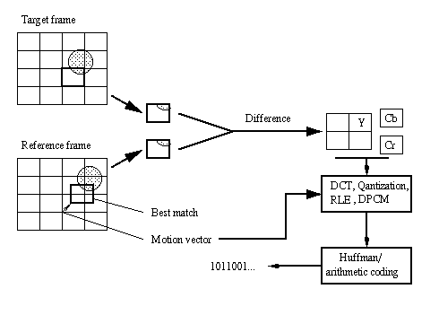
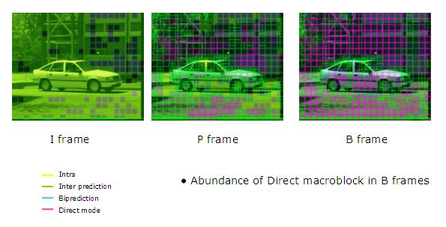
Why? Continued…

Slide 10
Questions?

